Slide 1

Java HTTP Client
Azat Satklichov
azats@seznam.cz,
https://github.com/azatsatklichov/Java-Features/tree/master/src/main/java/features/in/java11/httpclient

Slide 2
Agenda
HTTP 2 is still like HTTP 1.1 a. request, response based, b. GET/POS/DELETE, … methods
Difference: HTTP 2.0 – a. Binary protocol, Mandatory TLS, Multiplexing over single TCP conn. (streams), Server push capability
Java HTTP Client Libraries
Java HttpURLConnection
Introducing HttpClient
BodyHandler, Synch-Async Requests
HttpClient Configuration
BodyPublisher
Headers & Cookies
Security (Secure connections, HTTP Basic Auth)
Advanced HttpClient Features
Multiple Requests
WebSocket
File Download, Upload
HTTP/2 Server Push
Notes:
JavaScript is widely considered the “language of the web”
Criteria for Selection
When choosing JavaScript testing frameworks, there are going to be many options and different factors to consider. The following criteria are going to most influential in your decision:
E2E or Unit – An end-to-end framework is specialized to run through an entire human interaction on a website. A unit testing framework will give you different capabilities since it’s for testing single functions.
Assertions – Every end-to-end testing framework needs an assertion library. Assertions make sure that our tests return expected results. When choosing a framework, you also need to have a reason for choosing which assertion library you’re going to use and why you’re going to use it.
BDD/TDD Friendly – Some frameworks are not as easy to use with a BDD Girken style language as others, and you will want to stay away from those if your organization is following a certain style. Choose BDD or TDD and pick a framework that makes sense for your team and fits your organizational flow.
Asynchronous testing – When testing JavaScript, it’s important to worry about asynchronous testing and promises. Some frameworks will do this better out of the box than others, which will take longer to grab a promise.
Visual Testing – Some frameworks are better suited for visual testing and capturing browser screenshots than others, and some actually come out of the box with it. This will give you the ability to look at visual differences in your regression suite.
CI Integrations – If your team is following Continuous Integration and Delivery practices, it’s no surprise that you’ll also probably want a framework that integrates with Jenkins, Team City, and Bamboo. Most of the CI systems run on a standard runner, so they work hand in hand with many of the larger JavaScript frameworks to make sure that they work together as well as possible, but it’s still something you want to double-check when choosing.
App Language – The app language criteria has risen recently with the dynamic nature of JavaScript. Previously it was fine to have test code and production code not be the same language. Now, with the way app languages are going in frameworks, we want to pick a framework that is best suited for the actual language that our application is written in.
Speciality – You may be searching for a framework with a certain specialty. Is it easy to set up and get running out of the box? Is there a clean and simple syntax? Is it compatible with Angular testing or a Selenium binding? Does it have good customization? Is it flexible, and can it fit into other assertion libraries, code coverage tools, and frameworks? These are all considerations you’ll want to assess with your team.
Cloud Support – Pay attention to which frameworks work with cloud providers because not every framework will out of the box. Running tests in the cloud will allow you to increase test coverage and speed while eliminating hassle, cost, and maintenance, so compatibility should be part of your consideration.
Size of the Community – The size of the community matters because it’s where you look for answers and find tutorials and documentation, but this also depends on personal preference. For example, one framework may be good because it’s newer so more people are talking about it, but some might prefer a more mature framework that already has a good community base and documentation.

Slide 3
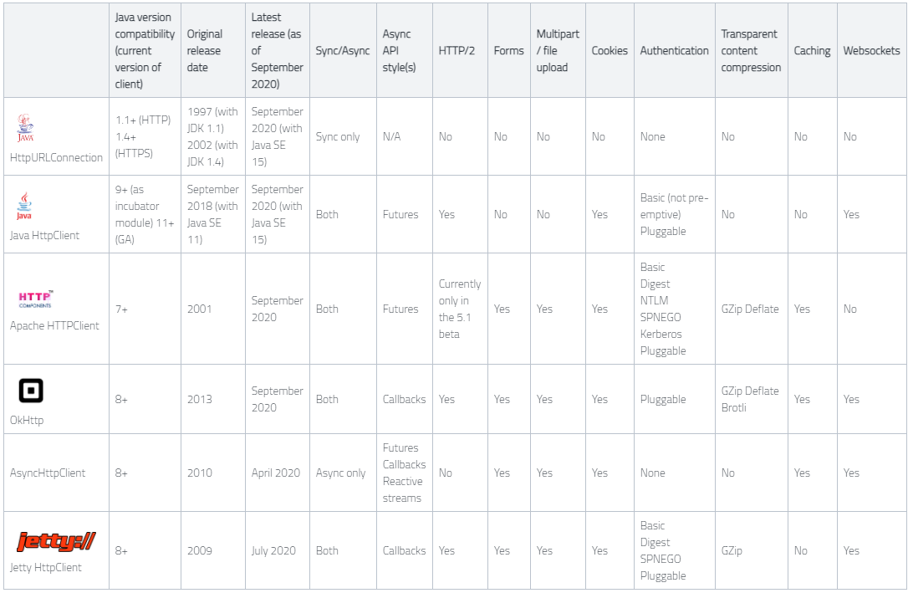
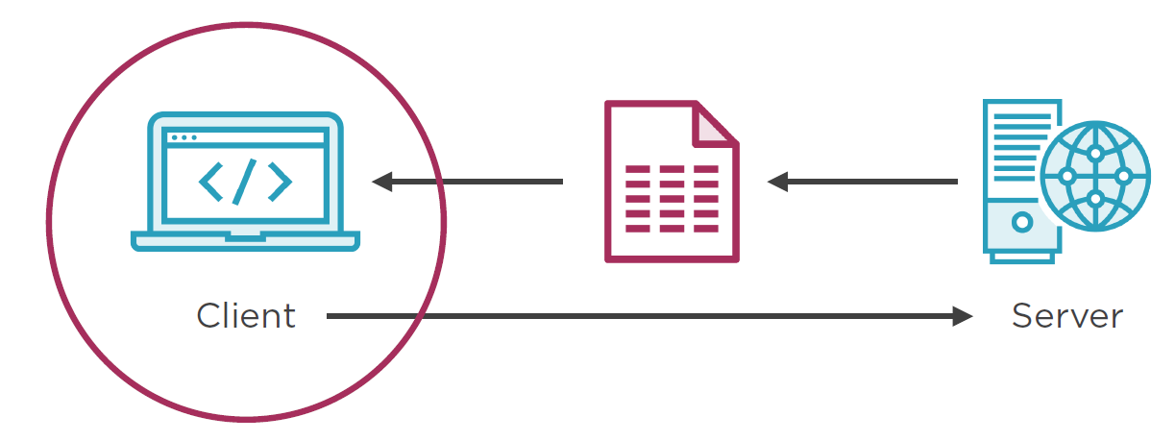
Java Http Client Libraries
Java 1.1 HttpURLConnection
Apache HttpComponents
Square's OkHttp
Retrofit built up-on OkHttp
JAX-RS REST Client
Jetty Http Client
AHC - Asyn Http Client
Google HTTP Java Client
. . .

Slide 4

Java HttpURLConnection
What's Wrong with HttpURLConnection?
Designed for HTTP/1.1
Since Java 1.1 so you can't use those benefits from Generics, Enums, Lambdas
You need to manage the edge cases, close connection etc
Casting URLConnection
Method names are string, e.g. GET, no ENUMs in Java 1.1.
Returns raw input stream, need to decorate it for readability
http client HttpUrlConnection doesn't support HTTP/2. Use OkHttp or Java11-http client
Before Java 11: Apache HttpComponents, Square's OkHttp, JAX-RS REST Client
public static void main(String[] args) throws Exception {
URL oracle = new URL("https://docs.oracle.com/javase/tutorial/networking/urls/readingWriting.html");
HttpURLConnection conn = (HttpURLConnection) oracle.openConnection(); //Casting
conn.setRequestMethod("GET"); //No ENUM
conn.setRequestProperty("User-Agent", "Java 1.1");
BufferedReader in = new BufferedReader(new InputStreamReader(conn.getInputStream())); //low-level
String inputLine;
. . .
An_Old_HttpUrlConnection.java
Notes:
Casting URLConnection, if server is HTTP server
Although the java.net package provides basic functionality for accessing resources via HTTP, it doesn't
provide the full flexibility or functionality needed by many applications. HttpClient seeks to fill this
void by providing an efficient, up-to-date, and feature-rich package implementing the client side of
the most recent HTTP standards and recommendations.

Slide 5
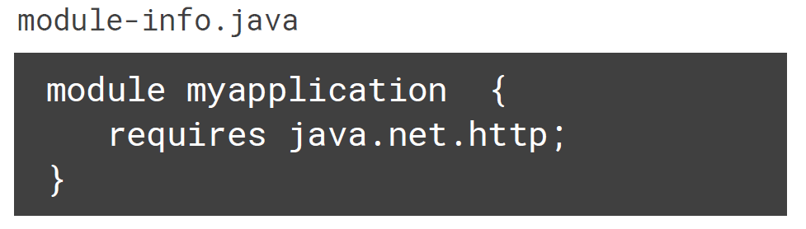
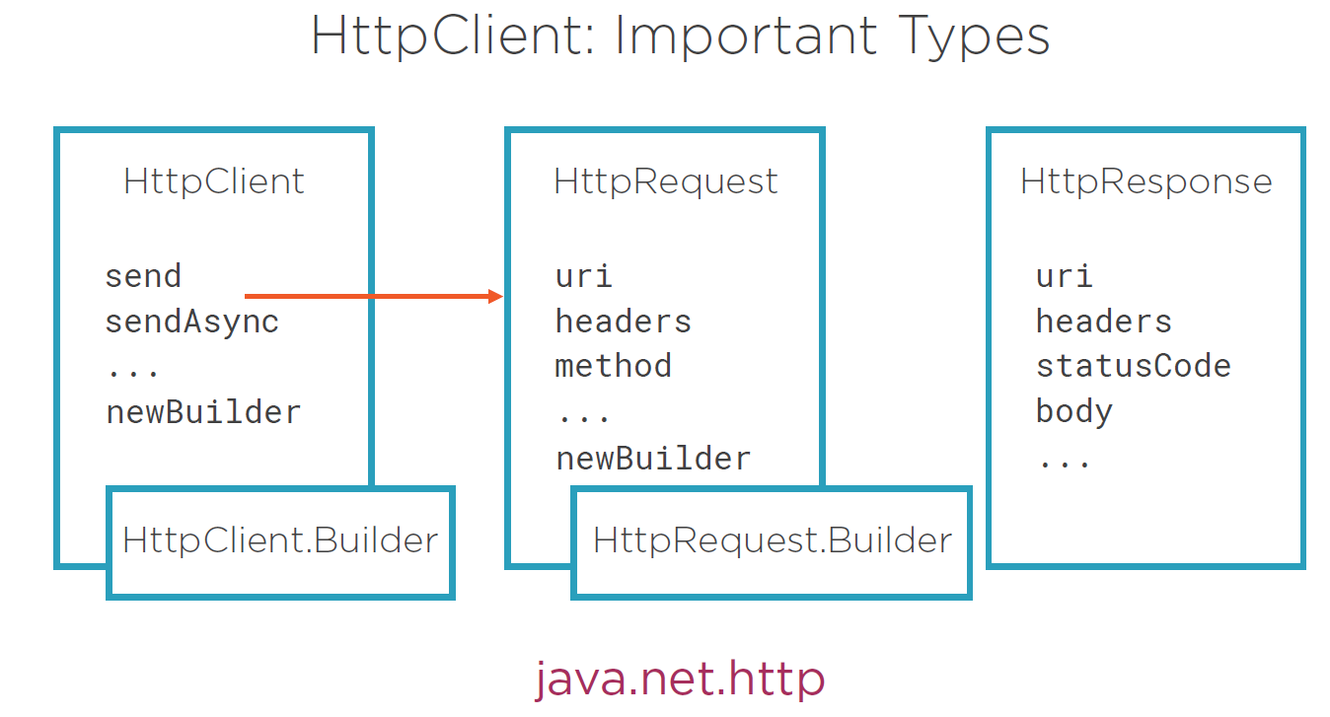
Introducing HttpClient
Introduced in Java 11 (easy and powerful)
Replaces HttpURLConnection API
Supports HTTP/2, WebSocket, Server Push, etc.
Sync & async methods
HttpClient Module – Java 9 modularity
???
Notes:
HTTP/2
The Java HTTP Client supports both HTTP/1.1 and HTTP/2. By default the client will send requests using HTTP/2. Requests sent to servers that do not yet support HTTP/2 will automatically be downgraded to HTTP/1.1. Here's a summary of the major improvements that HTTP/2 brings:
Header Compression. HTTP/2 uses HPACK compression, which reduces overhead.
Single Connection to the server, reduces the number of round trips needed to set up multiple TCP connections.
Multiplexing. Multiple requests are allowed at the same time, on the same connection.
Server Push. Additional future needed resources can be sent to a client.
Binary format. More compact.
Since HTTP/2 is the default preferred protocol, and the implementation seamlessly fallbacks to HTTP/1.1 where necessary, then the Java HTTP Client is well positioned for the future, when HTTP/2 is more widely deployed.
HTTP pipelining is a technique in which multiple HTTP requests are sent on a single TCP (transmission control protocol) connection without waiting for the corresponding responses.
HTTP 1.1 – Latency issue
The main role of HTTP/2 protocol is to improve the performance of web page.
The header transmitted text directly, while now it's compression transmission. In past, in the same TCP connection, only after the last response was sent could the server send the next one. While now it can send multiple responses together.
Server push is the only function that requires the developer himself to configure inside the HTTP/2 protocol. Other functions are automatically implemented by the server and browser.
Aside from solving common HTTP/1 performance problems (e.g., head of line blocking and uncompressed headers), HTTP/2 also gives us server push!
The Working Group presented HTTP/2 to the Internet Engineering Steering Group (IESG) for consideration as a Proposed Standard in December 2014,^{[6][7]} and IESG approved it to publish as Proposed Standard on February 17, 2015 (and was updated in February 2020 in regard to TLS 1.3).^{[8][9]} The HTTP/2 specification was published as RFC 7540 on May 14, 2015.[
data compression of HTTP headers
HTTP/2 Server Push
pipelining of requests
fixing the head-of-line blocking problem in HTTP 1.x
multiplexing multiple requests over a single TCP connection
What is new is how the data is framed and transported between the client and the server.
SPDY (pronounced like "speedy") was a previous HTTP-replacement protocol developed by a research project spearheaded by Google.
Vert.x 3.3 supports HTTP/2, Node.js Stable support since 8.13.0, Apache 2.4.12 supports HTTP/2 via the module mod_h2,
Apache Tomcat supports HTTP/2 with version 8.5
HTTP/3
- HTTP semantics are consistent across versions: the same request methods, status codes, and message fields are typically applicable to all versions. The differences are in the mapping of these semantics to underlying transports. Both HTTP/1.1 and HTTP/2 use TCP as their transport. HTTP/3 uses QUIC, a transport layer network protocol developed initially by Google where user space congestion control is used over the User Datagram Protocol (UDP).
https://en.wikipedia.org/wiki/HTTP/3
HttpClient is NOT a browser. It is a client side HTTP transport library. HttpClient's purpose is
to transmit and receive HTTP messages.
HttpClient will not attempt to process content, execute
javascript embedded in HTML pages, try to guess content type, if not explicitly set, or reformat
request / rewrite location URIs, or other functionality unrelated to the HTTP transport.
Concepts behind the CompletableFuture (uses ForkJoinPool by default (designed for this purpose). ) and reactive programming are
reaching parallelism using non-blocking operations, It understands tasks depend on other tasks, so avoids blocking threads, and
changing (context switch expensive) threads. It is an ideal candidate to write asynchronous systems.
In the case of asynchronous computation (it is usually multi steps), actions represented as callbacks tend to be either scattered
across the code or deeply nested inside each other. Things get even worse when we need to handle errors that might occur during one of the steps.
Since Java 5, the Future represents the result of an async-computation but it lacks methods to chain/combine the computation steps or handle possible errors, can’t be manually completed, and get() method is blocked.
You can not attach a callback function to the Future, and have it called automatically once Future’s result is ready
Since Java 5, the Future interface represents the result of an asynchronous computation but it lacks methods to combine the computation steps or handle possible errors. Moreover, its get() method is blocked.

Slide 6
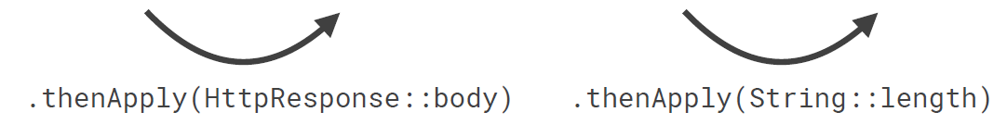
BodyHandler
ofString() String
ofByteArray() byte[]
ofFile(Path) Path
ofLines() Stream<String>
discarding() Void
D_HttpClientSynchronousDemo
Synch-Async Requests
public abstract <T> HttpResponse<T>
send(HttpRequest request, HttpResponse.BodyHandler<T> responseBodyHandler)
throws IOException, InterruptedException;
E_Asyn_CompletableFuture
public abstract <T> CompletableFuture<HttpResponse<T>>
sendAsync(HttpRequest request, BodyHandler<T> responseBodyHandler);
CompletableFuture<HttpResponse> CompletableFuture<String> CompletableFuture<Integer>
completableFutureIntegerResponse.thenAccept(System.out::println).join(); //or get()

Slide 7
HttpClient Configuration
H_HttpClientConfigDemo
Configuration affects all requests
Create multiple instances when necessary
Default Settings:
The default settings include: <code> prefer HTTP/2,
no connection timeout, redirection policy of NEVER, no cookie handler,
no authenticator, default thread pool executor, default proxy selector,
default SSL context
HTTP Version (HTTP_1_1, HTTP_2)
Priority
(Only affects HTTP/2 requests, Range 1-256 (inclusive))
Redirection –
e.g .followRedirects(Redirect.NORMAL, NEVER, ALWAYS)
Default Connection Timeout - .connectTimeout(Duration.ofSeconds(3))
[Not confuse with request timeout!]
Custom Executor - .executor(exec)
Custom settings e.g.
var client = HttpClient.newBuilder()
.authenticator(Authenticator.getDefault())
.connectTimeout(Duration.ofSeconds(30))
.cookieHandler(CookieHandler.getDefault())
.executor(Executors.newFixedThreadPool(2))
.followRedirects(Redirect.NEVER)
.connectTimeout(Duration.ofSeconds(5))
.priority(1)
.proxy(ProxySelector.getDefault())
.sslContext(SSLContext.getDefault())
.version(Version.HTTP_2)
.sslParameters(new SSLParameters())
.build();
Notes:
Connect timeout (10s-30s): How long to wait to make an initial connection e.g. if service is currently unavailable.
Socket timeout (10s-20s): How long to wait if the service stops responding after data is sent.
Request timeout (30s-300s): How long to wait for the entire request to complete.

Slide 8
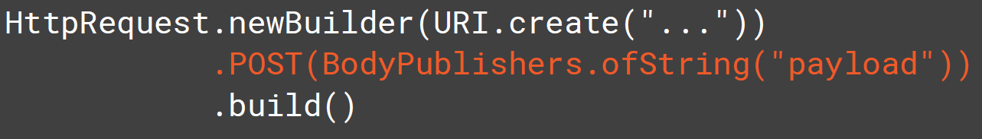
BodyPublisher
POST, PUT, PATCH, method - used as a PAYLOAD as being BODY PUBLISHER
I_HttpClientBodyPublishers
POST(BodyPublisher publisher)
PUT(BodyPublisher publisher)
method(String method, BodyPublisher publisher)
Pre-defined BodyPublishers
BodyPublisher is a sub-interface of Flow.Publisher, introduced in Java 9.
Similarly, BodySubscriber is a sub-interface of Flow.Subscriber.
This means that these interfaces are aligned with the reactive streams approach,
which is suitable for asynchronously sending requests using HTTP/2.
ofString(String body)
ofByteArray(byte[] buf)
ofFile(Path p)
ofInputStream(Supplier<? extends InputStream> s)
noBody()
Request with Body

Slide 9
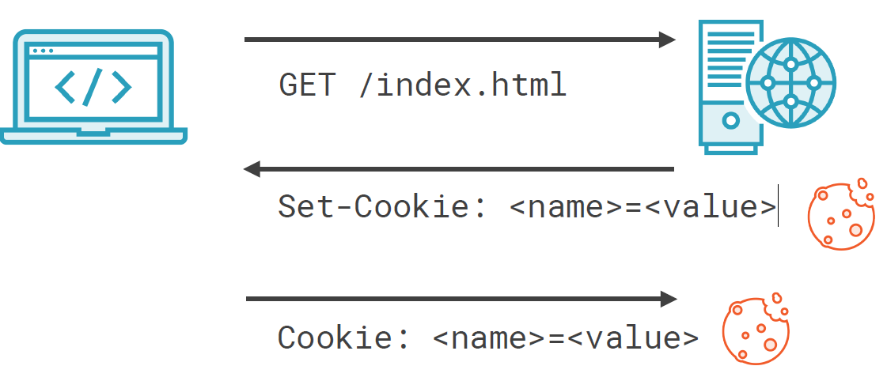
Headers & Cookies
Cookies – are persistent, used to manage state, token, etc …
HttpClient.Builder::setCookieHandler(CookieHandler handler)
CookieManager cookieManager = new CookieManager(null, CookiePolicy.ACCEPT_ALL);
httpClient = HttpClient.newBuilder().cookieHandler(cookieManager).build();
//CookieStore: Default in-memory implementation
System.out.println(cookieManager.getCookieStore().getCookies());
Headers - e.g. host-name is mandatory, we pass it automatically, ...
HttpRequest httpRequest = HttpRequest.newBuilder(URI.create("http://jsonvat.com/"))
.header("Accept", "text/html").header("content-language", "en-us")
.headers("User-Agent", "Java", "Cache-Control", "no-transform", "Cache-Control", "no-store")
// to replace header
.setHeader("Accept", "application/json")
.POST(BodyPublishers.ofString("some body infor form"))
.build();
J_HttpClientCookiesAndHeadersDemo

Slide 10
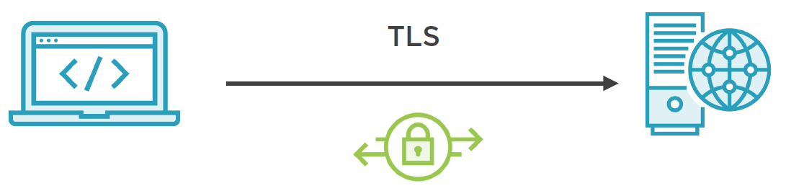
Security
Secure Connections
Default set of root Certification Authority (CA) certificates[public keys] since Java 10. >C:\apps\Java\jdk-11\lib\security > keytool -list -keystore cacerts >changeit
Self-signed certificates (not in above list) add your CA to trust store (1)
>$JAVA_HOME/bin/keytool -Djavax.net.ssl.trustStore /path/to/truststore
Mutual authentication (Add client certs[private keys] to a key store (2))
>$JAVA_HOME/bin/keytool -Djavax.net.ssl.keystore /path/to/keystore
SSLContext - Create custom SSLContext with trust store (1) / keystore (2)
SSLParameters - TLS version, algorithms, etc.
//Create custom SSLContext
SSLContext sslCtx = SSLContext.getDefault();
/* TLSv1.2 or TLSv1.3 */
SSLParameters sslParameters =
new SSLParameters(new String[]
{ "TLSv1.3" },
new String[] {"TLS_AES_128_GCM_SHA256" });
HttpClient httpClient = HttpClient.newBuilder()
.sslContext(sslCtx).sslParameters(sslParameters)
.build();
HTTP Basic Authentication (e.g. Usages in Servlets, Spring) credentials == base64(user + ":" + password)
1. Use Authenticator 2. Proxy - also used for security purposes as well
Authenticator authenticator = new Authenticator() {
protected PasswordAuthentication getPasswordAuthentication() {
return new PasswordAuthentication("admin", "secret".toCharArray()); }
};
// ProxySelector proxySelector = ProxySelector.getDefault();
ProxySelector proxySelector = ProxySelector.of(new InetSocketAddress("company.proxyserver.com", 8080));
HttpClient httpClient = HttpClient.newBuilder().authenticator(authenticator).proxy(proxySelector).build();
Notes:
- Djavax.net.ssl.trustStore – where root Certification Authority (CA) certificates in the JDK, or self-signed ones
- Djavax.net.ssl.keyStore - keeps client certs (private keys)
SSLParameters - TLS version, algorithms, etc.
use keytool (or OpenSSL) to generate and
- Djavax.net.ssl.trustStore – where root Certification Authority (CA) certificates in the JDK, or self-signed ones
- Djavax.net.ssl.keyStore - keeps client certs (private keys)

Slide 11
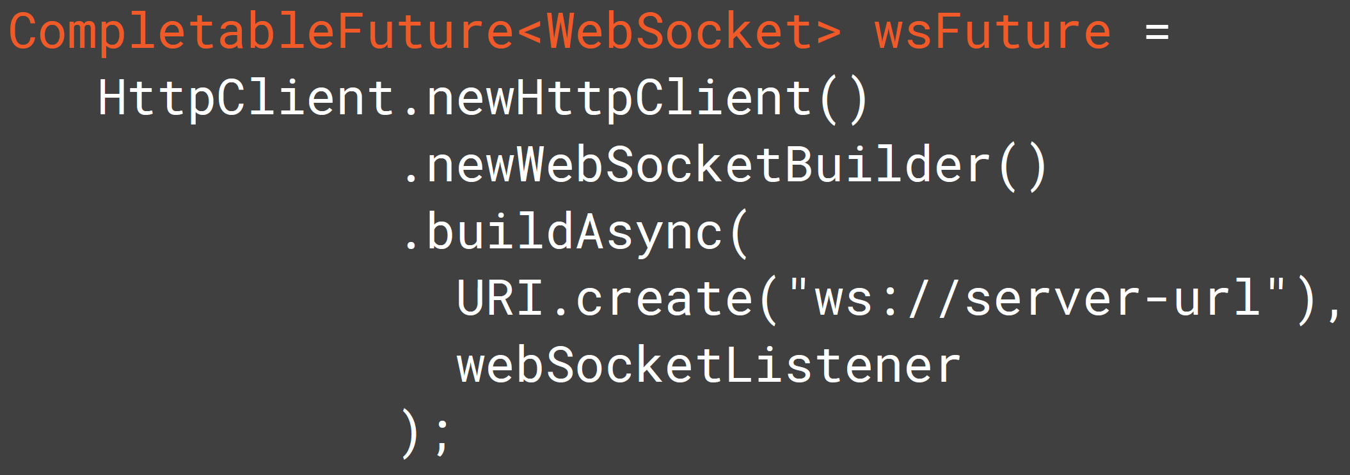
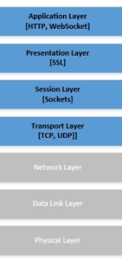
Advanced HttpClient Features - WebSocket
The java.net.http module also contains a client for WebSocket communication
Real time, Message-based protocol
Full-duplex, bi-directional communication
Text and binary
URI schemes - ws, wss
WebSocket.Listener – has default
methods, just implement
one you need
onOpen
onClose
onError
onText
onBinary
onPing
onPong
Java 9 brings support for reactive programming or
distributed asynchronous programming via
the publish/subscribe protocol that forms the basis
of Flow API — SubmissionPublisher,
Flow [Publisher, Subscriber, Subscription,
and Processor]. Also Java 11 http2-client embraces
the concurrency and reactive programming ideas.
Notes:
You can use an HttpClient to create a WebSocket using the newWebSocketBuilder() factory method.
WebSocket is a computer communications protocol, providing full-duplex communication channels over a single TCP connection.
Unlike HTTP, WebSocket provides full-duplex communication.^{[2][3]} Additionally, WebSocket enables streams of messages on top of TCP.
WebSocket was first referenced as TCPConnection in the HTML5 specification, as a placeholder for a TCP-based socket API
WebSocket provides an alternative to the limitation of efficient communication between the server and the web browser by providing bi-directional, full-duplex, real-time client/server communications. The server can send data to the client at any time. Because it runs over TCP, it also provides a low-latency low-level communication and reduces the overhead of each message
HTTP is a request-response protocol. The client (browser) wants something, the server gives it. That is. If the data client wants is big, the server might send streaming data to void unwanted buffer problems. Here the main requirement or problem is how to make the request from clients and how to response the resources(hypertext) they request. That is where HTTP shine.
WebSocket is not a request-response protocol where only the client can request. It is a socket(very similar to TCP socket). Mean once the connection is open, either side can send data until the underlining TCP connection is closed. It is just like a normal socket. The only difference with TCP socket is WebSocket can be used on the web. On the web, we have many restrictions on a normal socket. Most firewalls will block other ports than 80 and 433 that HTTP used. Proxies and intermediaries will be problematic as well. So to make the protocol easier to deploy to existing infrastructures WebSocket use HTTP handshake to upgrade. That means when the first time connection is going to open, the client sent an HTTP request to tell the server saying "That is not HTTP request, please upgrade to WebSocket protocol".
The only difference with TCP socket is WebSocket can be used on the web
On the web, we have many restrictions on a normal socket. Most firewalls will block other ports than 80 and 433 that HTTP used. Proxies and intermediaries will be problematic as well. So to make the protocol easier to deploy to existing infrastructures WebSocket use HTTP handshake to upgrade. That means when the first time connection is going to open, the client sent an HTTP request to tell the server saying "That is not HTTP request, please upgrade to WebSocket protocol".
Concepts behind the CompletableFuture and reactive programming are reaching parallelism using non-blocking operations, and ForkJoinPool (in fork/join framework) is designed for this purpose.
It understands tasks depend on other tasks, so avoids blocking threads, and changing (context switch expensive) threads. It is an ideal candidate to write asynchronous systems.
Reactive Programming is creating systems that are responsive to events in other words it is programming with asynchronous data streams.
A reactive application is based on asynchronous processing of one or more flows of events conveyed by reactive streams (responsive, resilient, elastic, and message-driven).
Monolithic applications with big data have slow response times, and offline maintenance support is a real issue. Reactive programming addresses these issues by allowing you to process and combine streams of data items coming from different systems and sources in an asynchronous way via micro-services.

Slide 12
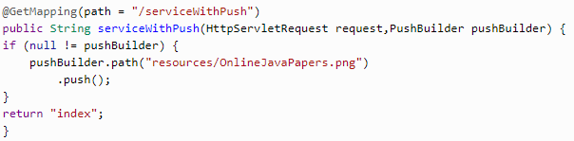
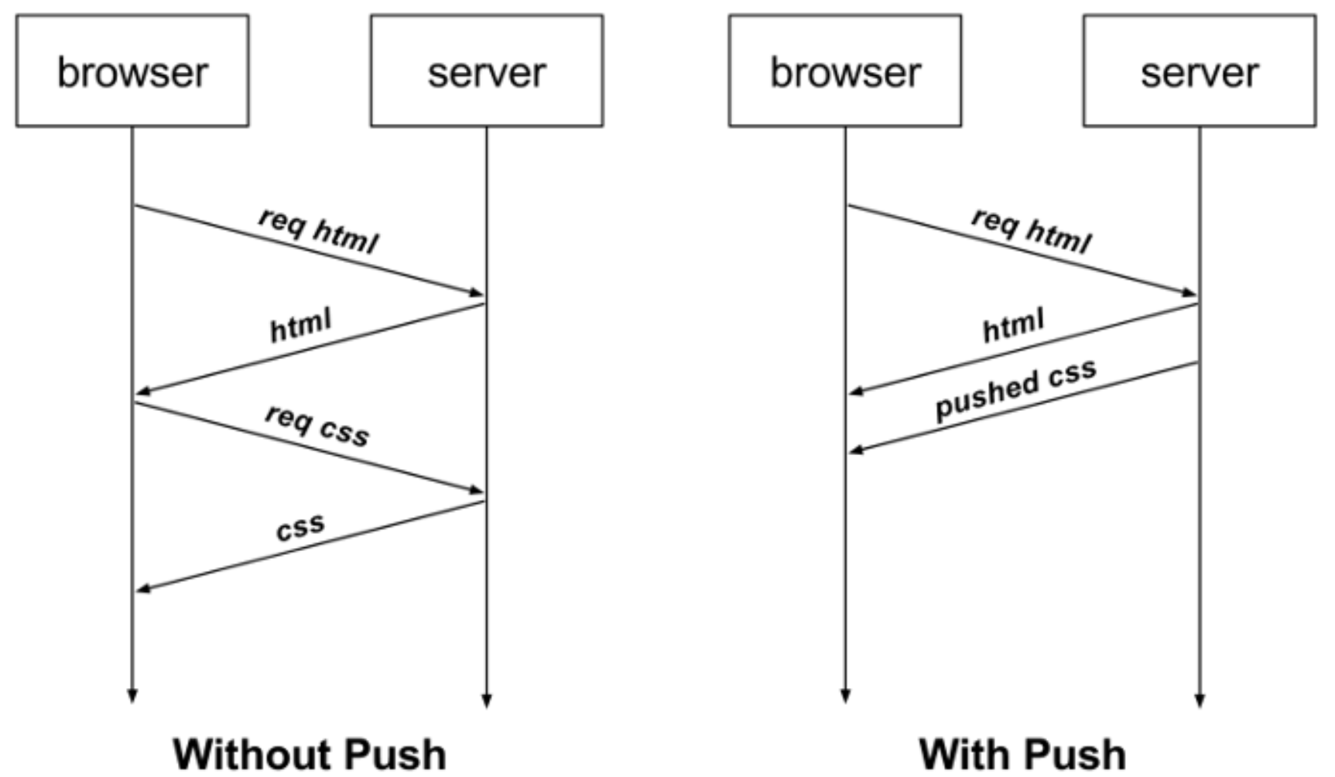
Advanced HttpClient Features - HTTP/2 Server Push
Push Promise
HTTP/2 Server Push allows an HTTP/2-compliant servers (Tomcat, Jetty, Node.js, Nginx, Wildfly, .. ) to send resources to a HTTP/2-compliant client before the client requests them. Old way was: preloading of resources
PushPromiseHandler
HttpClient::sendAsync(HttpRequest request,
BodyHandler bodyHandler,
PushPromiseHandler pushHandler)
Config in Spring Boot App: server.http2.enabled=true
//endpoint, which would be powered by HTTP/2 Push Technology
//or via Servlet API
var resultMap = new ConcurrentHashMap<HttpRequest, CompletableFuture<HttpResponse<String>>>();
PushPromiseHandler<String> pph = PushPromiseHandler.of(pushPromise -> BodyHandlers.ofString(), resultMap);
client.sendAsync(request, BodyHandlers.ofByteArray(), pph)
Notes:
https://www.javacodegeeks.com/2018/07/http-2-server-push.html
https://medium.com/@mena.meseha/http-2-server-push-tutorial-d8714154ef9a
Server push is the only feature in the HTTP/2 protocol that developers need to configure themselves.
Server push is the only function that requires the developer himself to configure inside the HTTP/2 protocol. Other functions are automatically implemented by the server and browser.
Server push is the ability of the server to anticipate what will be needed by the client in advance of the client’s request. It lets the server pre-populate the browser’s cache in advance of the browser asking for the resource to put in the cache.
Because of this assumption, it pushes them into the cache (called server.http2.enabled=true') before they are actually needed.
HTTP/2 Server Push allows an HTTP/2-compliant server to send resources to a HTTP/2-compliant client before the client requests them.
Aside from solving common HTTP/1 performance problems (e.g., head of line blocking and uncompressed headers), HTTP/2 also gives us server push!
Server push allows you to send site assets to the user before they’ve even asked for them.
It’s an elegant way to achieve the performance benefits of HTTP/1 optimization practices such as inlining, but without the drawbacks that come with that practice.

Slide 13
Advanced HttpClient Features - Multiple Requests
L_MultipleRequests

Slide 14
Advanced HttpClient Features – File Download/Upload
N_FileDownloadUpload

Slide 15
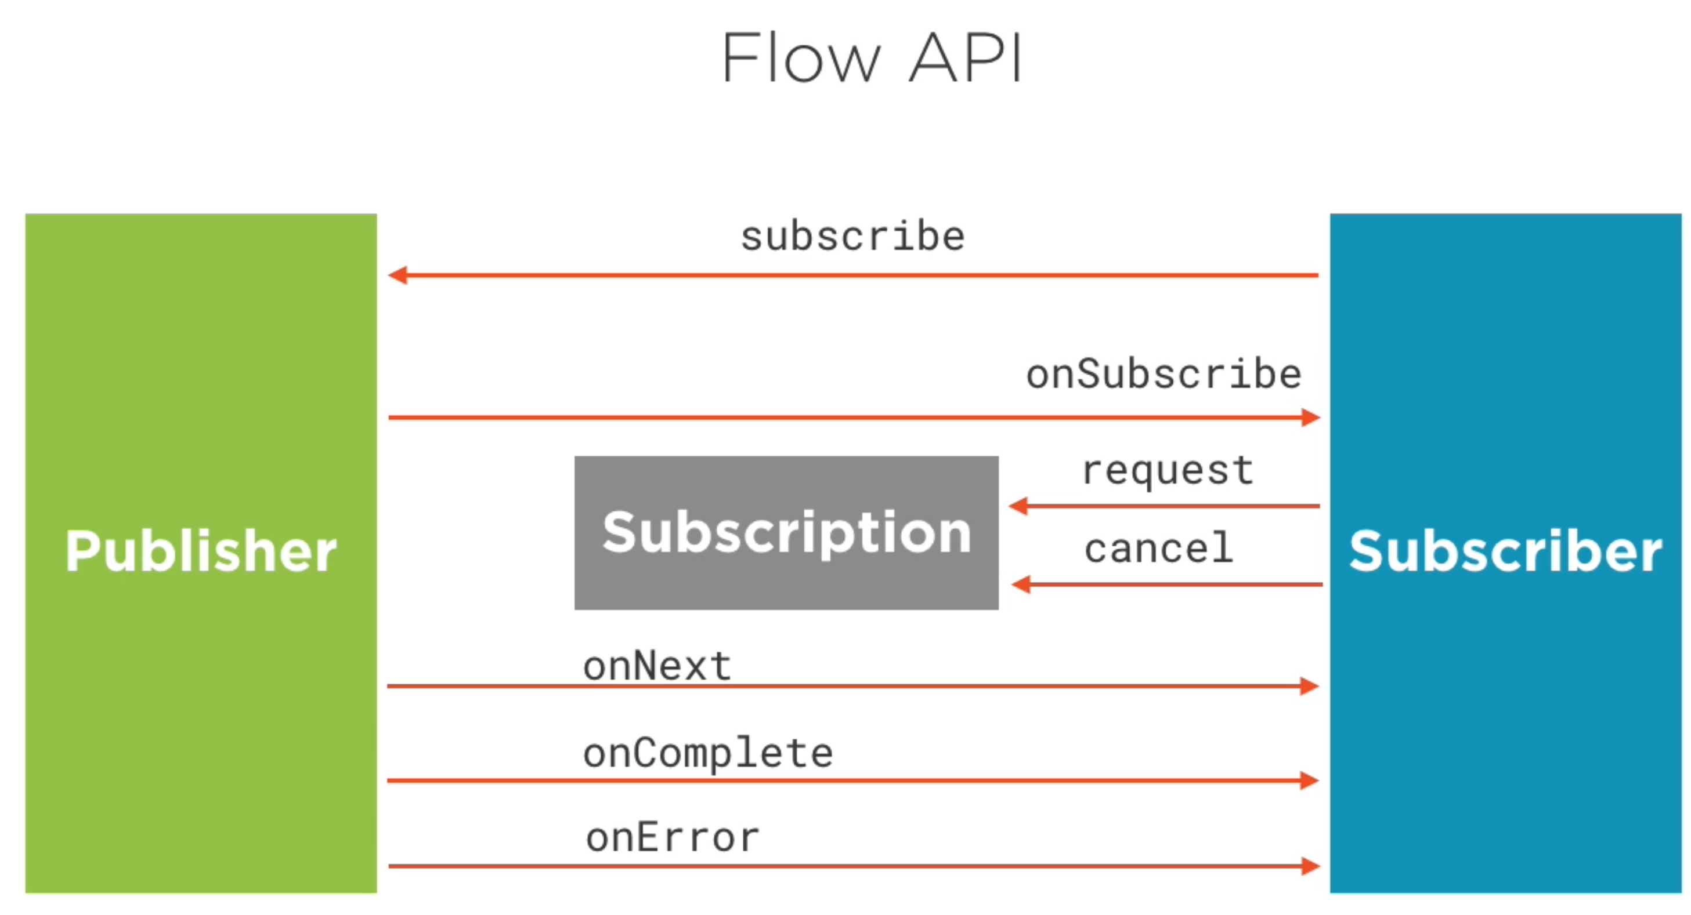
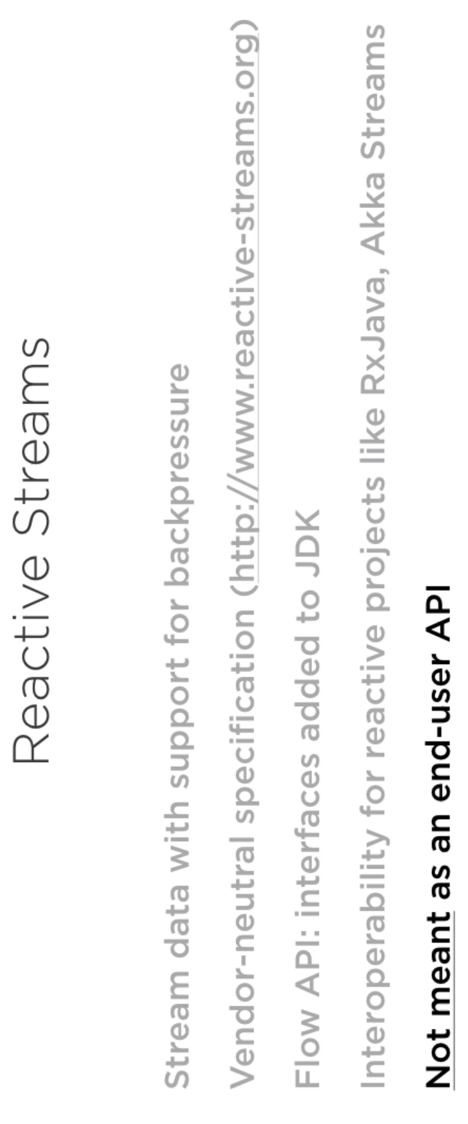
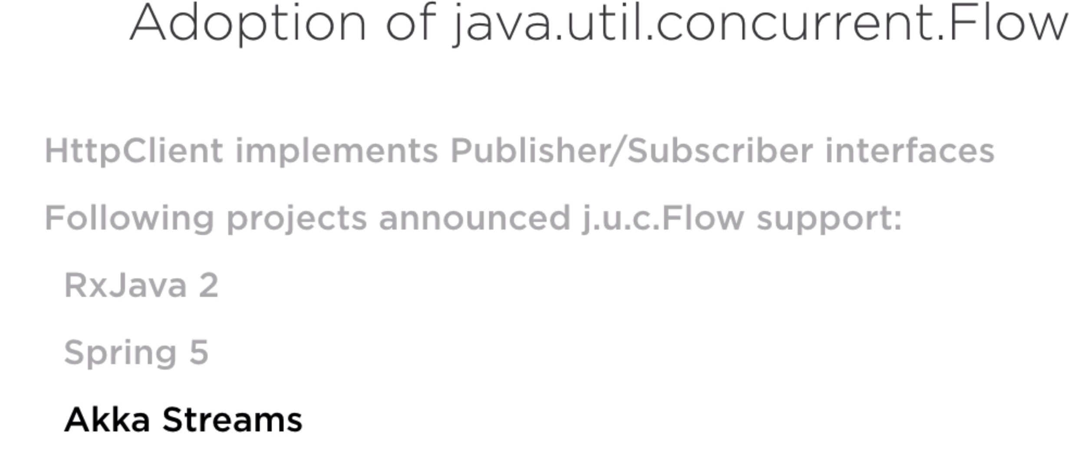

Slide 16

THANK YOU
References
https://openjdk.java.net/groups/net/httpclient/intro.html
https://factoryhr.medium.com/http-2-the-difference-between-http-1-1-benefits-and-how-to-use-it-38094fa0e95b
https://developer.ibm.com/languages/java/tutorials/java-theory-and-practice-3/

